Slide 1
beachtination
Dare to be bold and travel with us

Slide 2


Slide 3

HOME
FAMOUS DESTINATIONS
CONTACT US
SUBSCRIBE
ABOUT US
TRAVEL TIPS

Slide 4


Slide 5


Slide 6
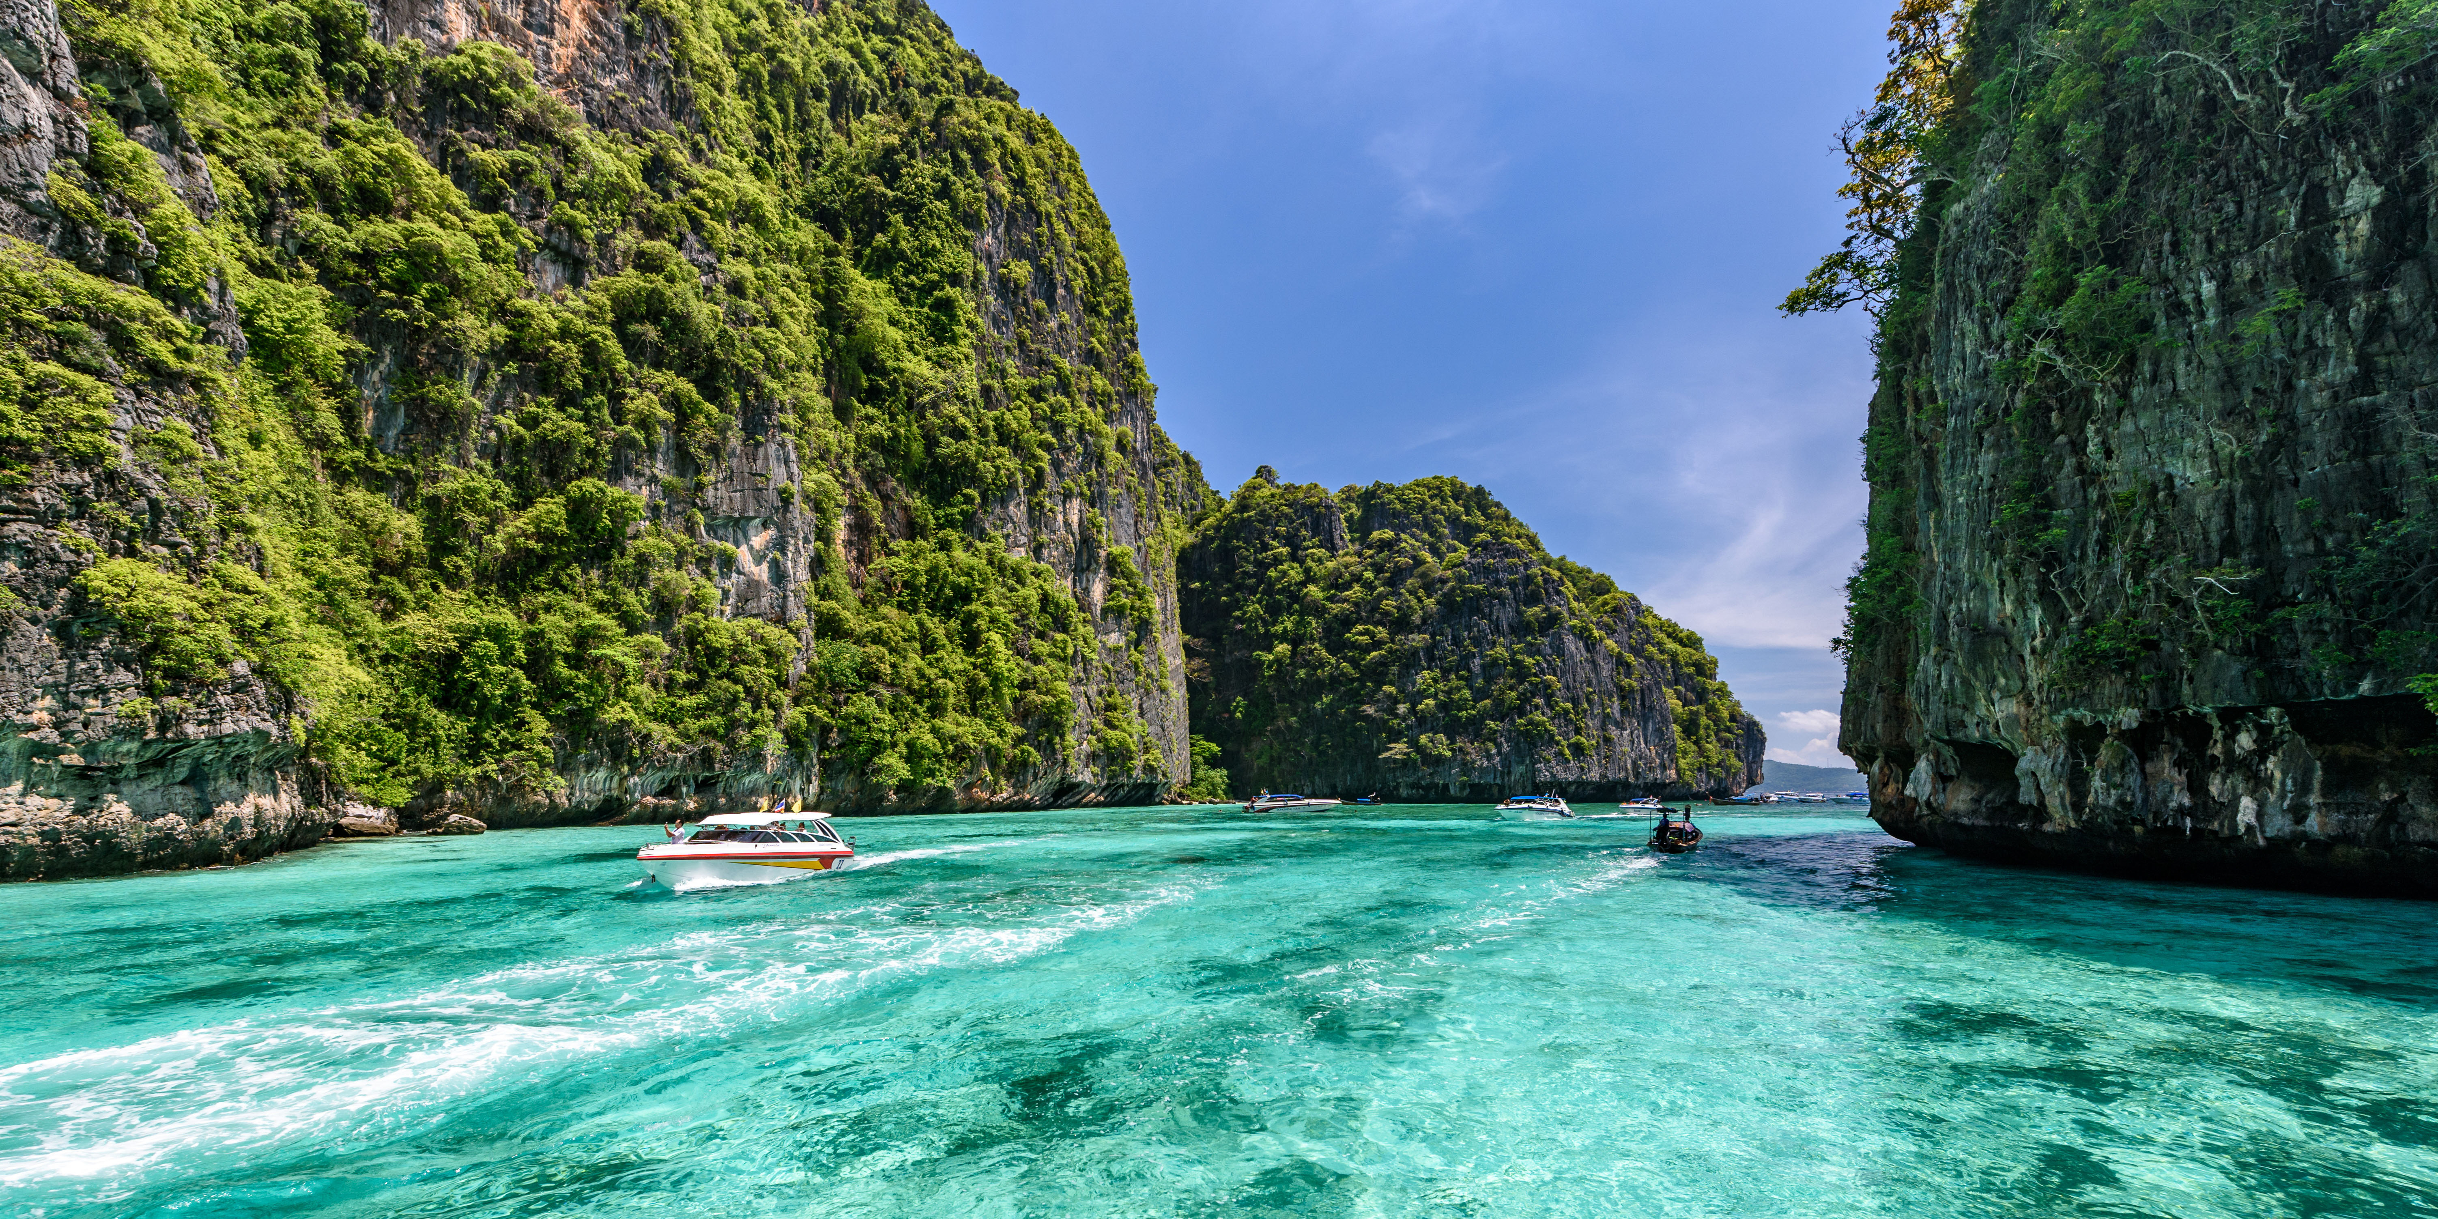
Coron:
Paradise in your neighborhood

Slide 7
About Us
BUY NOW
$20.00
SHARE YOUR JOURNEY WITH US
View More

Slide 8


Slide 9

DARE TO BE BOLD AND EXPLORE WITH US

